Slide 1

How League of Legends works ?

Slide 2

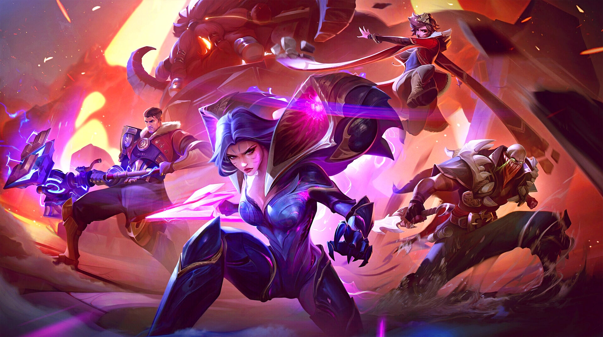
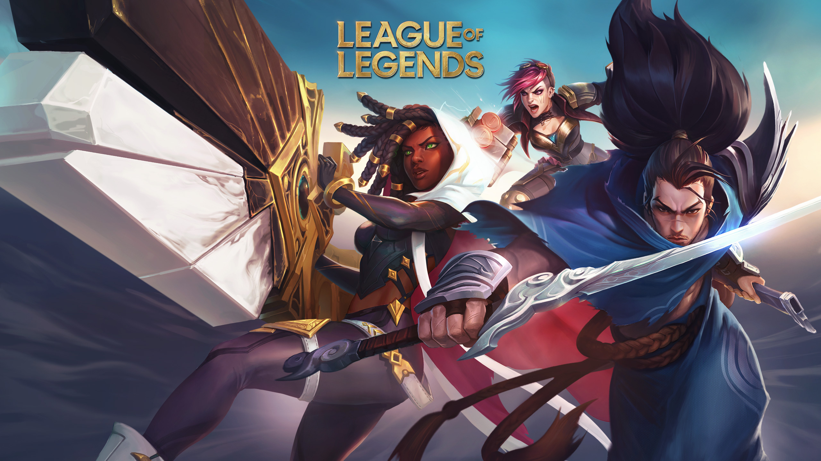
Agenda
Topic one: Introduction
What is “League of Legends”
Topic two: Business
How profitable is the game ?
Topic three: Technical Part
How does it actually work ?
Topic four: Summary
What’s next ?

Slide 3
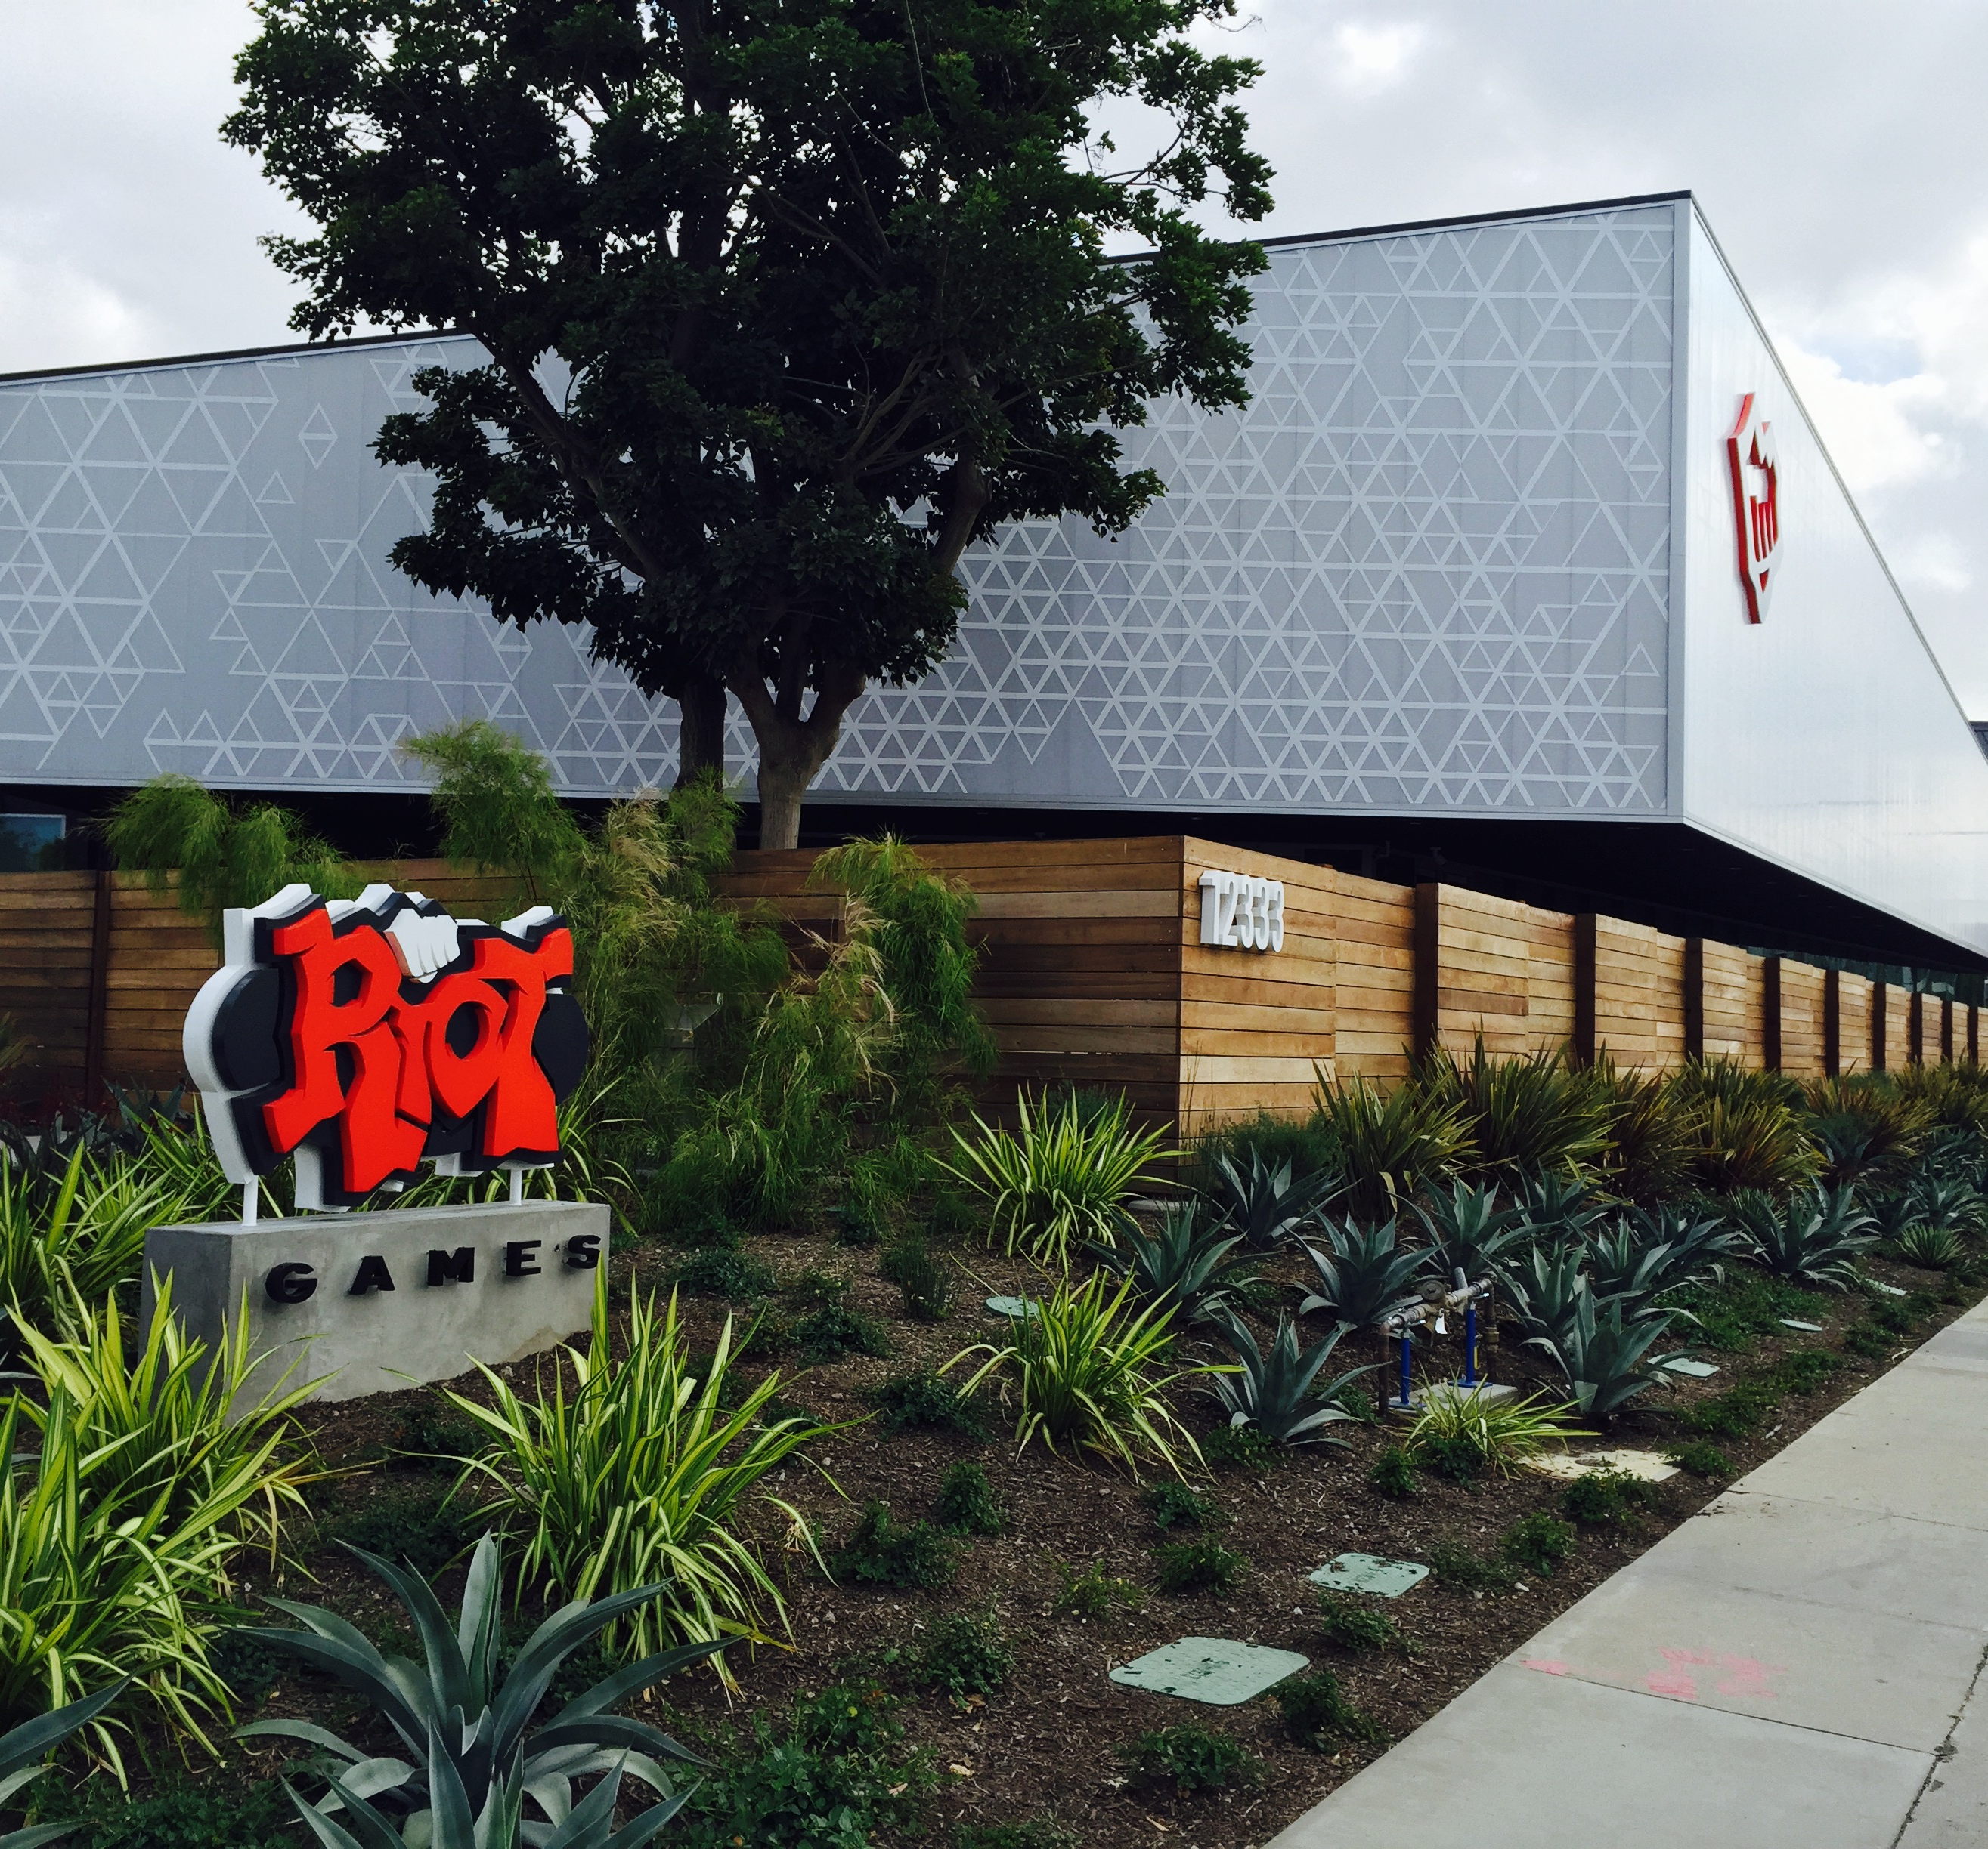


Introduction
Since this is one of my favorite games I decided to make a presentation about itself. Simply put, League of Legends is an online MOBA (multiplayer online battle arena) where players battle each other using in-game champions. With hundreds of different champions available in game, players must work together with their teammates in order to defeat the other team.
The game is made / developed by the company Riot Games

Slide 4
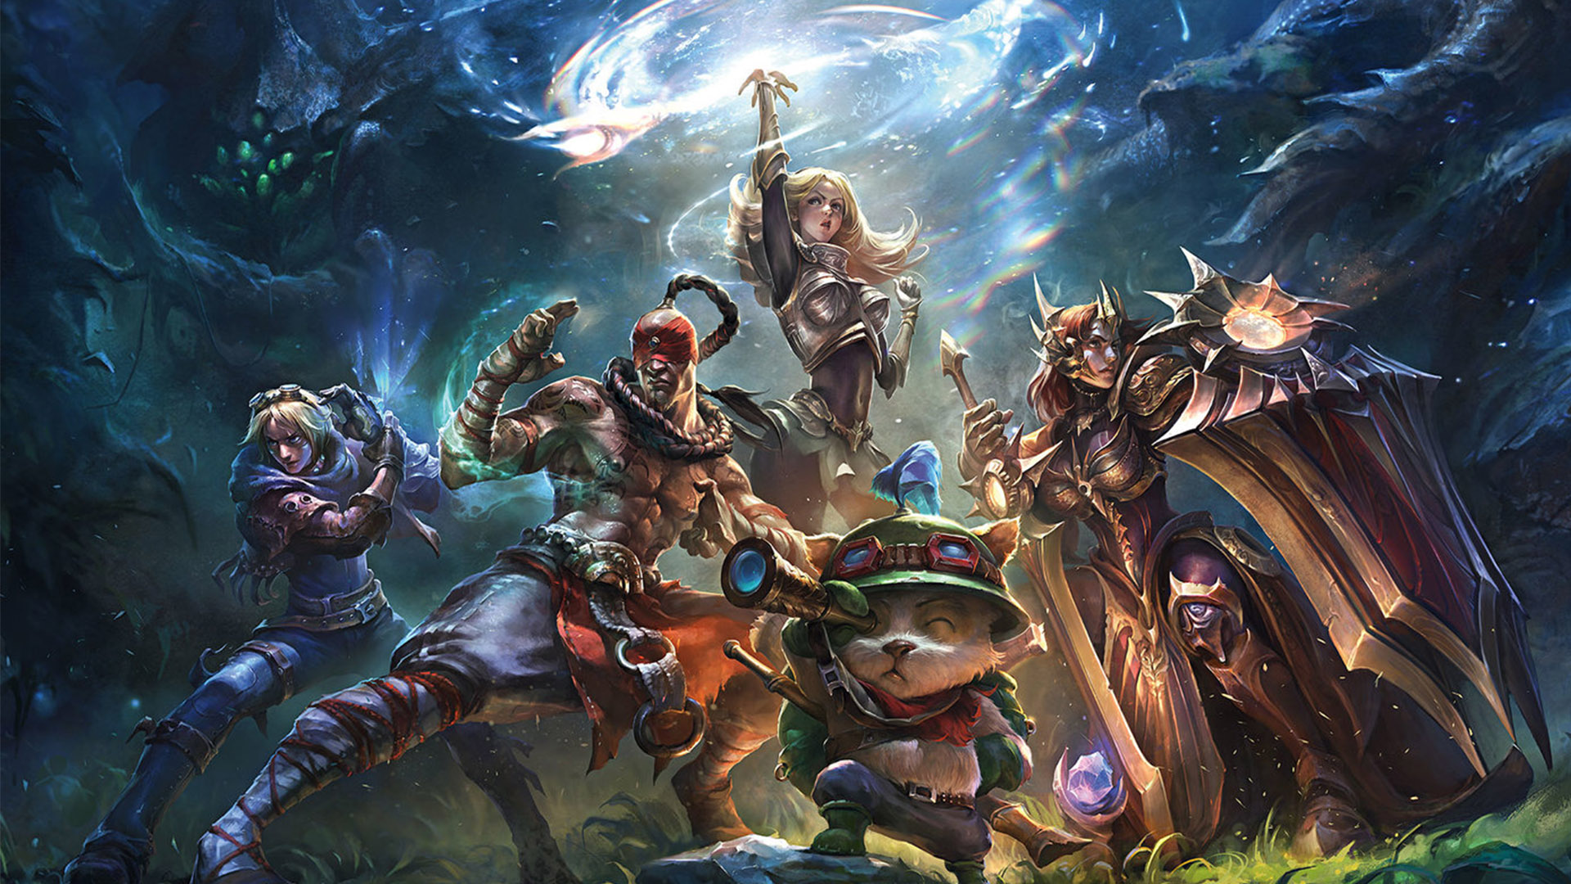
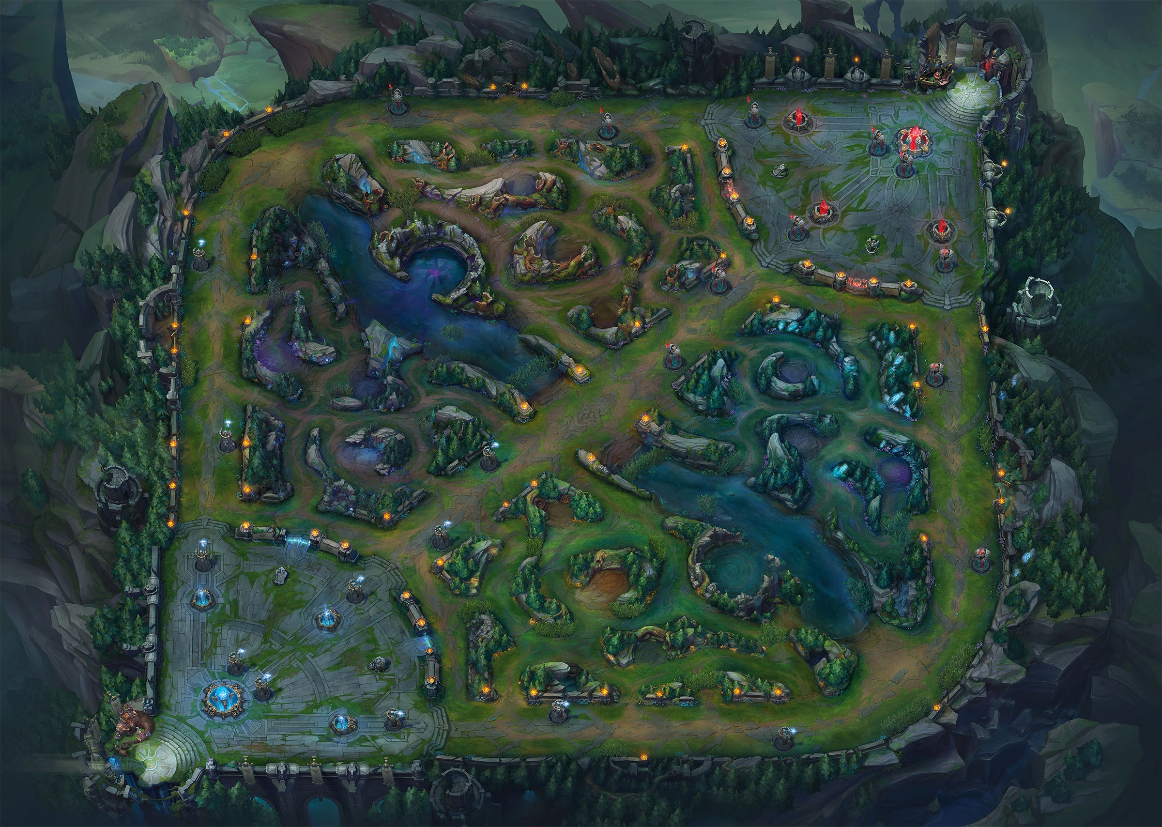
To summarize a MOBA for you, 5 players on each team join an arena that consists of 3 lanes. Each lane has minions that spawn and travel down the lane until they meet the enemies minions in the middle. Each team has 3 towers in each lane followed by an inhibitor which leads into your base. Inside your base is a Nexus guarded by 2 more towers. For a team to win they must destroy the other team's Nexus or make the other team surrender.
If you are interested more about the game I will include direct link to a video I made 2 years ago explaining League of Legends in details.

Slide 5

Business
When we think of video game companies making money, like the Riot Games business model is successfully doing, what comes to mind is usually consoles that cost more than $400 and games with prices over $60 each.
However, the most played game in the world, League of Legends, is a free game that, as incredible as it may seem, assures the company an annual profit of more than 1.75 billion dollars. We don’t misspell, it’s billion, indeed.
But how can a game that I can just download on my mobile and for which I don’t have to pay a cent get revenue like that?

Slide 6
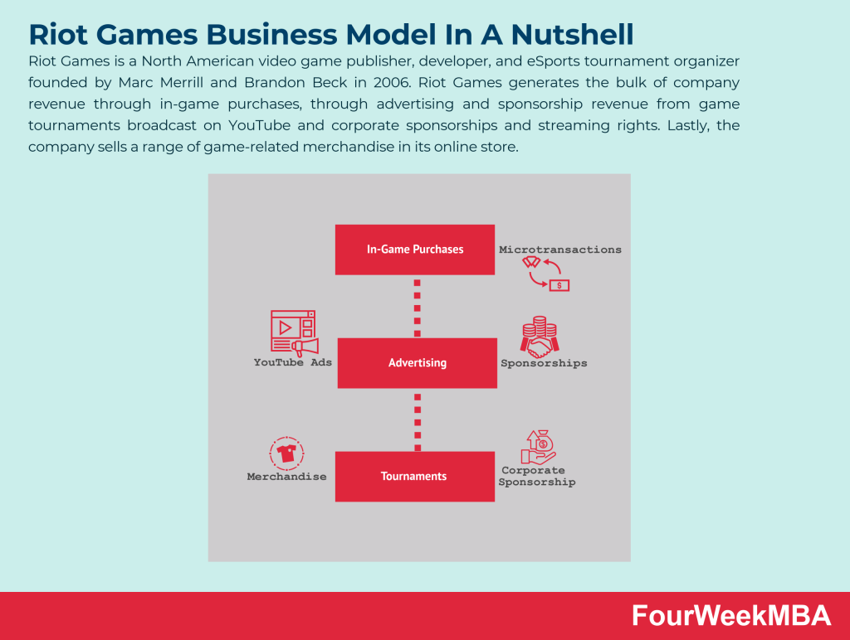
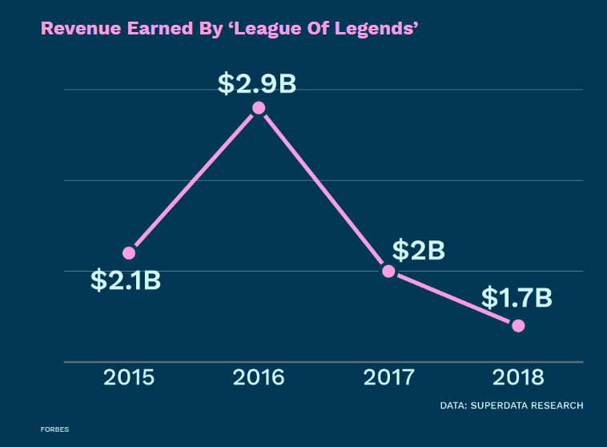

Slide 7
Here are the 4 ways how League of Legends makes money
League of Legends has a revenue model that makes money in four 4 ways through in-game purchases, ad revenue, ticket sales from LoL eSports live events, and selling merchandise.
#1. In-game Purchases (via Riot Points)
What are Riot Points? RP, formerly known as Riot Points, is League of Legends’ in-game currency that allows users to purchase and use this currency to buy things like skins, champions, chromas, and more in-game items.
#3. LoL eSports Live Events (Ticket Sales)
In addition to streaming tournaments, League of Legends also makes money through selling tickets to these LoL eSport events. These events are live in-person tournament events where fans who purchase tickets can watch these gamers live at the venue - which is held in various parts of the world.
#2. Ad Revenue (from YouTube Ads)
With a combined 6.84+ million subscribers across their 9 LoL YouTube channels, the League of Legends brand also makes money by monetizing the YouTube video content they upload to their channels.
These 9 channels upload content like live broadcasts of pro play across all global leagues including the World Championship. As well as weekly highlights, gameplay breakdowns, commentary, and more.
#4. Selling Merchandise (Riot Games Store)
Another way League of Legends makes money is by selling its own merchandise through its official online Riot Games Store.
Here, they sell branded League of Legends apparel, collectibles, accessories, and more that range in price between $5 to $940+ USD.

Slide 8

"The darker the night, the brighter the stars."
Braum (Champion from LoL)

Slide 9

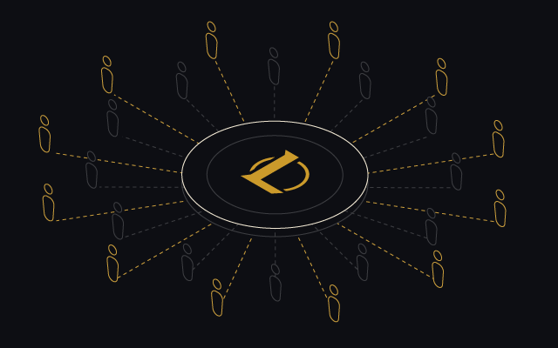
Technical Part

Slide 10

The Architecture of the League Client
Issue #1 - HTML5 is a standardized, widely adopted platform
Pure HTML5 and JavaScript have become viable desktop client technologies. This brings many advantages including standardized workflows and development tools, along with a large pool of talented developers. We really want to fully harness this platform and the media integrations it allows.
Issue #2 - Riot dev teams want to work in harmony
The original codebase was structured around a small, highly cohesive team and didn’t give the required level of autonomy and independence as the number of features teams grew. This problem of dev teams colliding with each other wasn’t going away - it was getting worse over time as we added new features. In addition, we aspire to be a multi-game studio, which brings many other challenges and opportunities.

Slide 11
Incrementing towards an awesome architecture
Step A: JavaScript is the king of the world!
Since we were planning on building the UI using HTML and JavaScript, initially we felt that putting all the business and communications logic in JavaScript also would simplify the architecture and keep it uniform. (The impulse for this type of uniformity between UI and services lies at the heart of platforms like node.js.)
As such, we developed a simple and minimal C++ library allowing JavaScript to invoke remote calls via RTMP and handle asynchronous responses. We kept RTMP because it works well for our current scale, and because we didn’t want to change the communications protocol at the same time as changing the client.
Based on some internal prototyping, we decided to use ember.js as our single page application framework, and ember-orbit as our data layer.

Slide 12
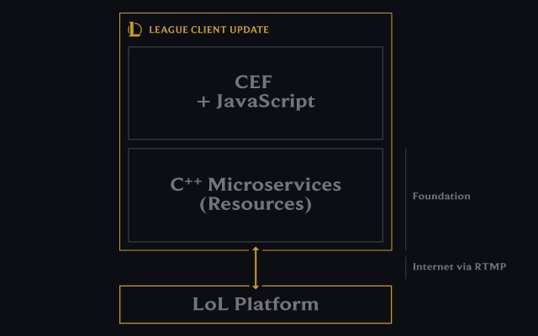
Step B: We rediscovered web apps (but
Our next step was to provide microservices in C++, presenting the async game protocol as a set of REST resources.
We started thinking about how normal web applications are designed, and we realized we were missing a middle tier. We built a microservice layer (still running on the player’s desktop) to present the RTMP protocol as REST resources, to insulate the JavaScript from so much async. We used websockets to handle events back to the UI. We called this microservices layer the ”foundation.” on the desktop)!

Slide 13
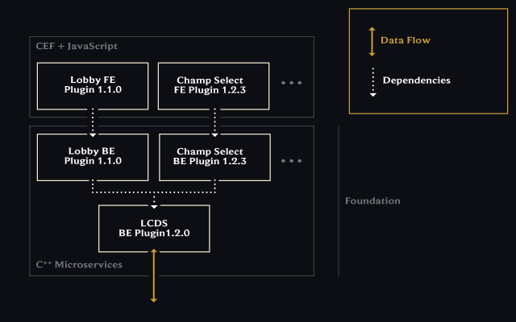
Step C: Still stepping on toes…
So, a UI screen or feature goes into what we call a front-end (FE) plugin, and C++ communications logic goes into a (somewhat confusingly named) back-end (BE) plugin. Note that both types of plugin live inside the new client - we used the terms front and back-end because the architecture mimics a typical client-server architecture, even if it is inside a single desktop process.
We then allow the set of plugins chosen for a player to be based on what entitlements that player has. Entitlements are used to control regional-specific features and will also be used to give access to new games.

Slide 14
Step D: Ask N JavaScript developers for their favorite MVC framework. Get N+1 answers.
We now had a much more productive architecture and teams were able to make screens and services quickly, with clear separation of responsibilities.
However, we had a developer problem. Some of the teams really didn’t like Ember.js and wanted to use web components directly. Other teams already had their own web apps written in a variety of frameworks that they wished to host inside our new client.
At this point we were still reluctant to relax the "Ember.js for all” rule just for developer preference. Removing the assumptions related to Ember as the single embedded framework was going to take some serious work.
The turning point came when we realized that a client platform for a company the size of Riot cannot even force everyone onto the same version of Ember. It was painful, but we ended up architecting the client to allow each plugin to potentially have its own framework—the JavaScript framework became part of the domain of each front-end plugin.

Slide 15
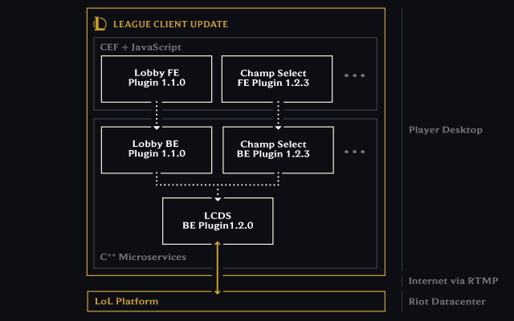
The final architecture
The target architecture for the updated client now addresses our three original issues well. It’s an engine which allows multiple teams to independently deliver HTML5-based features without unnecessary dependencies, using supporting communications infrastructure to allow players to remain connected. It’s effectively a hosting engine for C++ microservices and JavaScript web apps, where the choice of plugins is personalized and dynamic, based on a player’s entitlements. One of the developers commented that we’d made a "datacenter in a desktop." From another perspective, I realized we'd created the game client equivalent of Atom, Github’s CEF-based extensible text editor based on the Electron framework. Interesting stuff, and I would never have guessed that we'd end up here at the start.

Slide 16

Summary
Having established the extremes of engine-heavy and engine-light, and that they both work well and make for happy game-makers, here's the bad news - League's solidly between the two.
This is not a happy place. Our core engine exposes both high-level constructs and low-level primitives to the scripting engine. The scripting language itself is simple, providing the very basics, which is what you'd expect from a language supporting an engine-heavy setup, but we've built complex systems on top of it anyway.
As it stands today, there's high complexity everywhere, and we'd do better to move towards either extreme, so let's have a look at what those transitions could look like.

Slide 17

Thank You
Made by: Alexander Karaneichev
Email: stu2001261008@uni-plovdiv.bg
Fac.number: 2001261008

